Slide 1
Bank Loan Case Study Analysis
santosh lal choudhury

Slide 2
Project Description
The main aim of this project is to identify patterns that indicate if a customer will have difficulty paying their installments.
This information can be used to make decisions such as denying the loan, reducing the amount of loan, or lending at a higher interest rate to risky applicants.
The company wants to understand the key factors behind loan default so it can make better decisions about loan approval.
The dataset we will be working with contains information about loan applications. It includes two types of scenarios:
Customers with payment difficulties (1): These are customers who had a late payment of more than X days on at least one of the first Y installments of the loan.
All other cases(0): These are cases where the payment was made on time.

Slide 3
Analysis done
steps:
Identified Missing Data and handle missing data effectively to ensure the accuracy of the analysis by applying EDA to the Data Set.
Identified outliers in the loan application dataset by using functions like QUARTILE, IQR, and conditional formatting to identify potential outliers.
Analyzed Data Imbalance in the loan application dataset and calculated the ratio of data imbalance.
Performed Univariate, Segmented Univariate, and Bivariate Analysis to gain insights into the driving factors of loan default.
Identified Top Correlations for Different Scenarios and identified the top correlations for each segmented data.

Slide 4
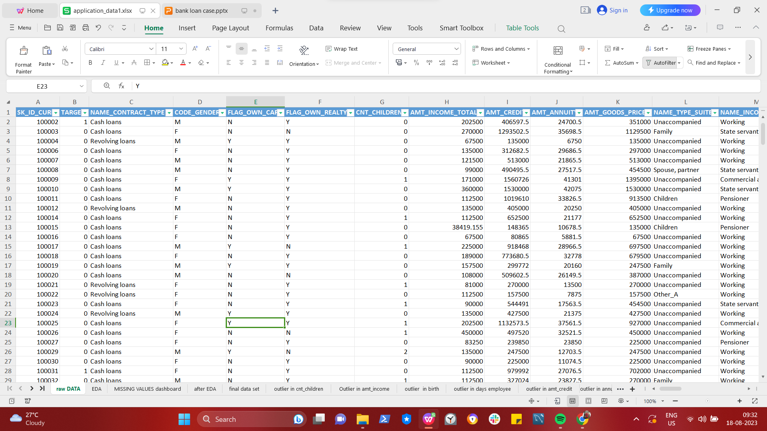
Tech-Stack Used
PP-WPS OFFICE, Product Version-12.2.0.13085 ,Publisher-Kingsoft corp.

Slide 5
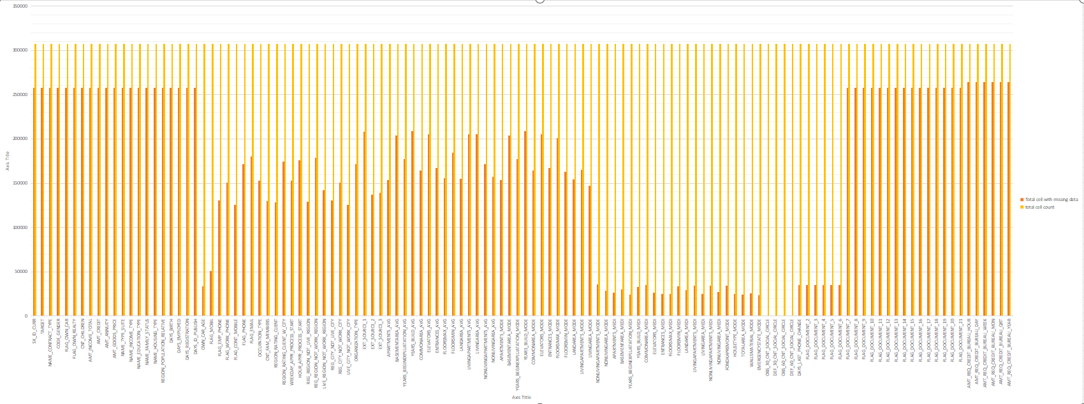
Missing values :
Bar with dark orange represents the missing values.
Bar with light orange presents total no of values.
Then removed the blank cells and unwanted column having more than 30% of blank value.

Slide 6
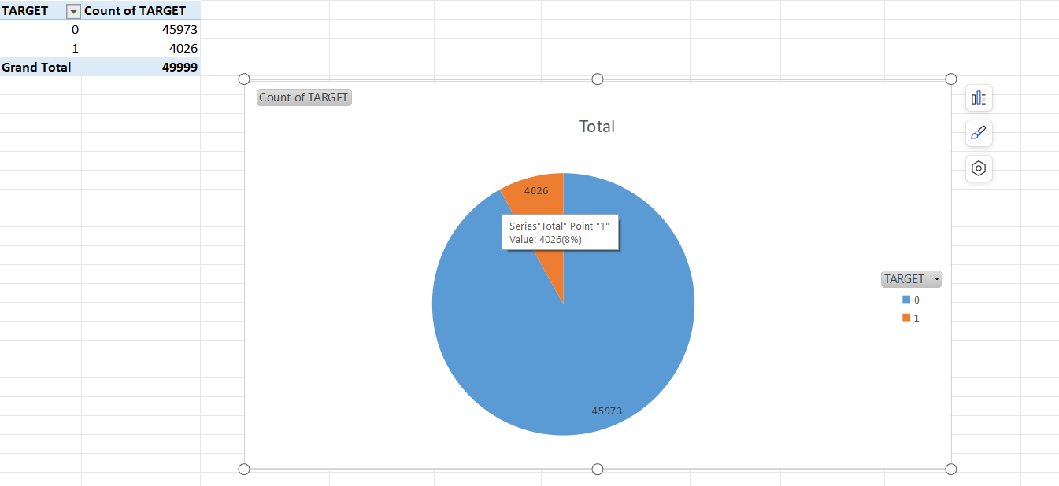
propotion of defaulters in total loan:
their are total 4026 defaulters.

Slide 7
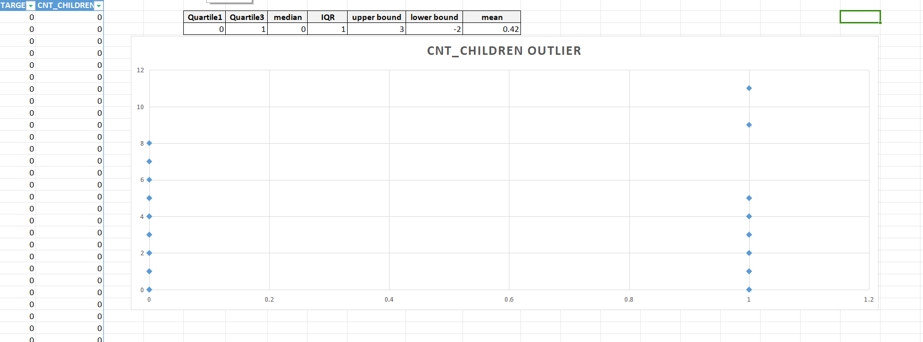
Outliers in the cnt_children(for target 0 &1):
Considering the present world population senerio having more than 3 children is not possible for some but may be possible for some person,so it needs to be futher investigated to check if the data entered is accurate or not.
According to the statistic performed on the data ,targets having more than 3 children is an outlier.

Slide 8
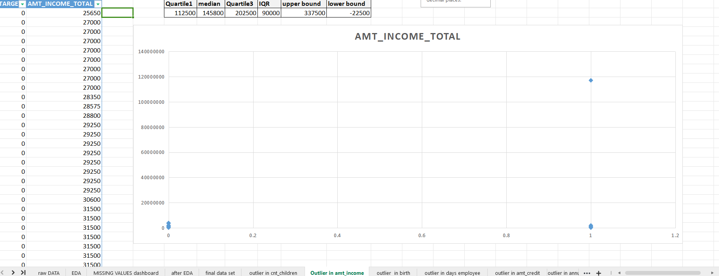
Outliers in the amt_income(for target 0 &1):
after applying statistic to the data i get to know that income greater than 337500 are outlier but in real case senerio income greater than 337500 are valid data points.

Slide 9
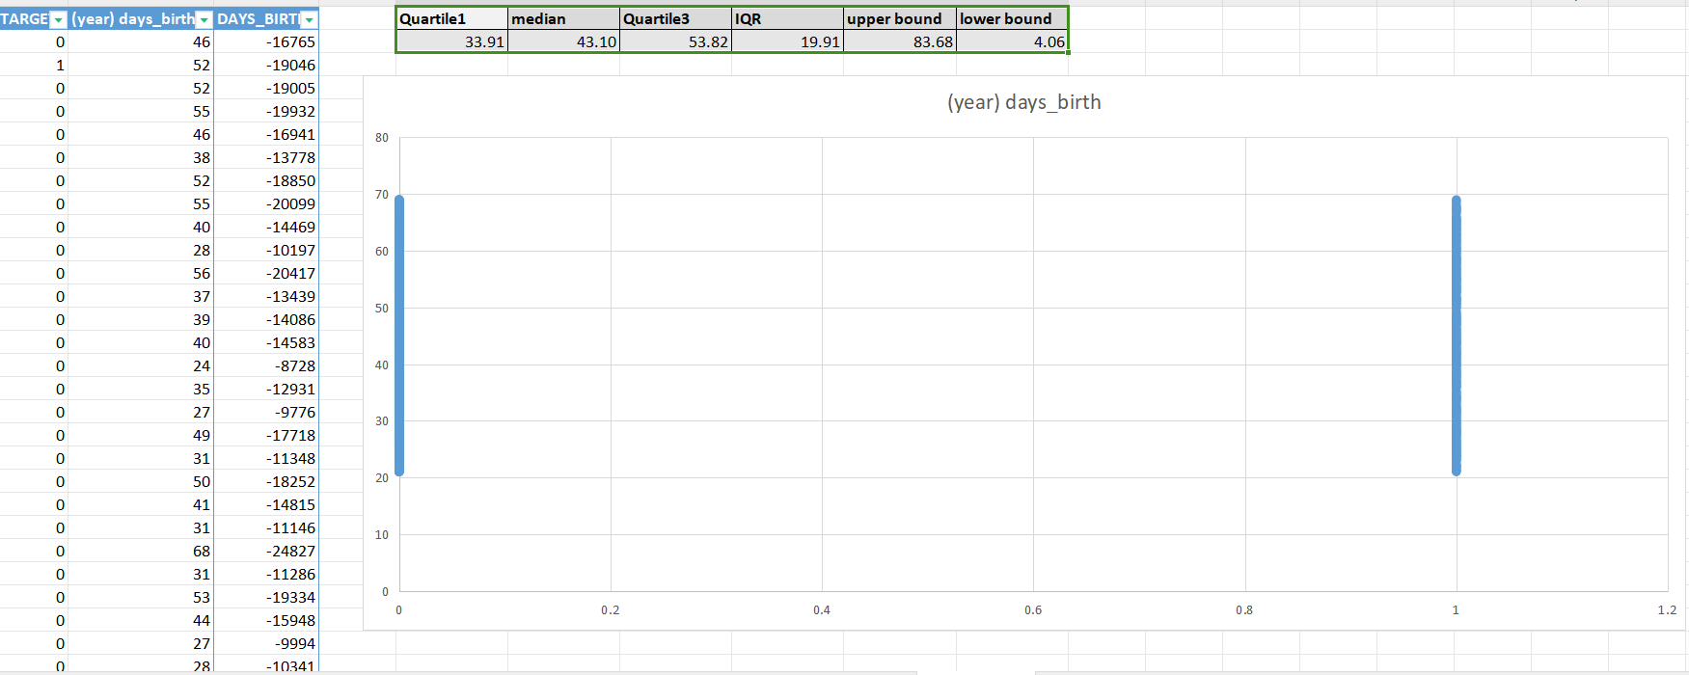
Outliers in the age(for target 0 &1):
their are no outlier in age column data are valid.

Slide 10
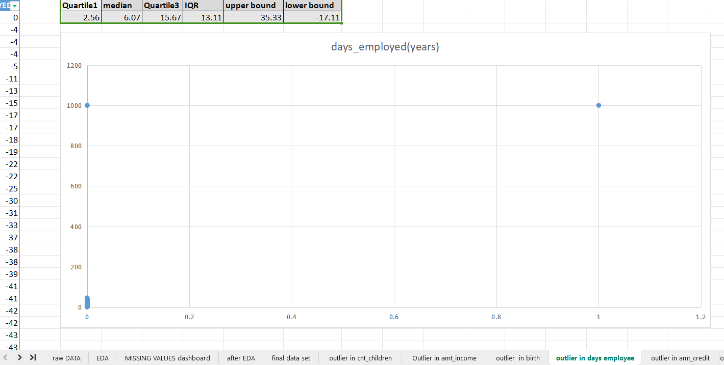
Outliers in the days_employed(for target 0 &1):
outlier present in the dataset are not valid as a human cant live for 1000 years so how can he be employed for 1000yr,so the data point is not valid and need futher investigation.

Slide 11
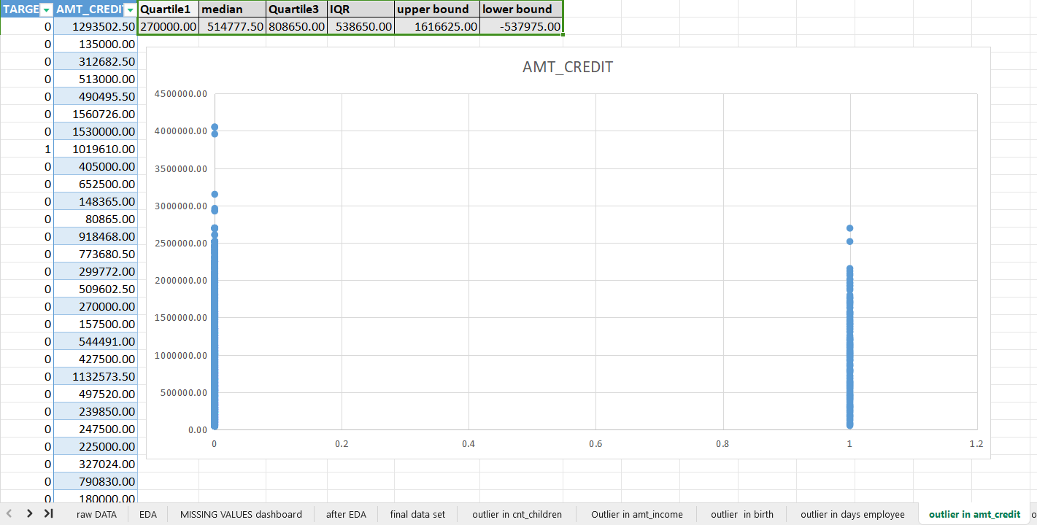
Outliers in the Amt_credit(for target 0 &1):
the outlier present in this data are valid because their is no fix amount given in credit.

Slide 12
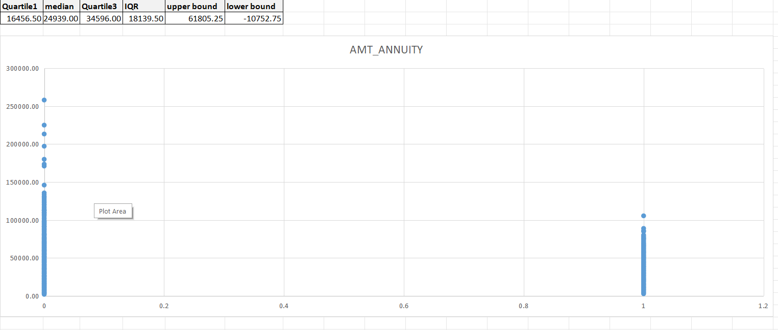
Outliers in the Amt_Annuity(for target 0 &1):
the outlier present in this are valid as annuity amount depends on the credit amount ie. higher credit amount=higher annuity to be paid.

Slide 13
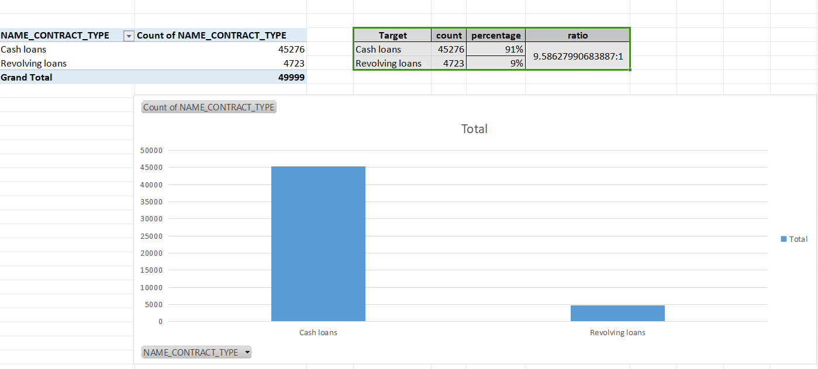
Data Imbalance in contract_type(for target 0 &1):
the data imbalance ratio is 9.5:1.
their are more cash loan as compair to revolving loan

Slide 14
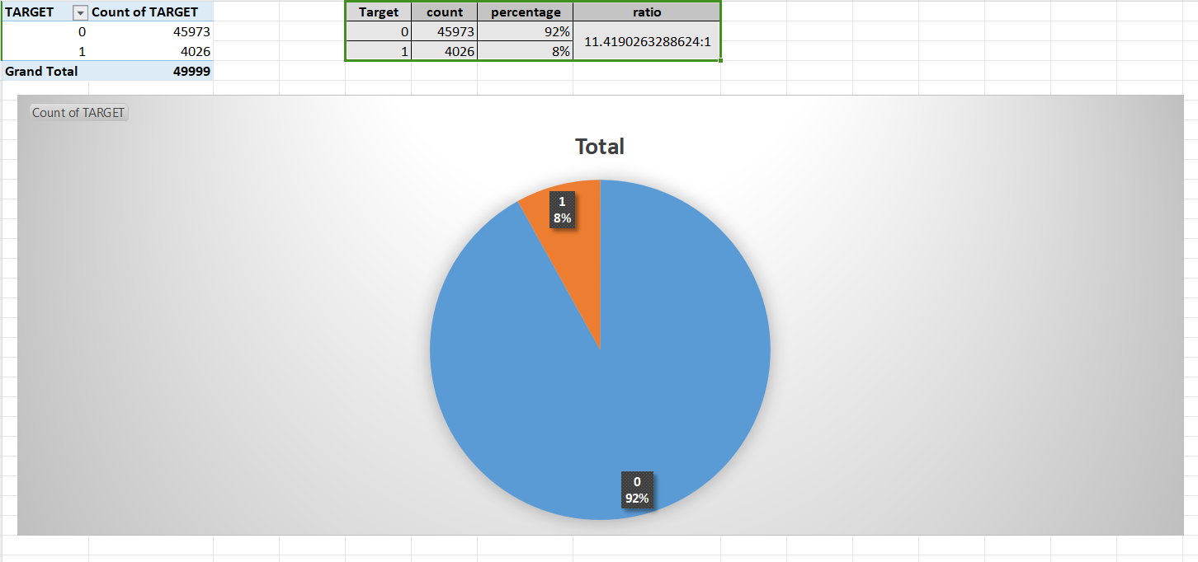
Data Imbalance in target(for target 0 &1):
the ratio between 0&1 is 11.4:1
target 1 is only 8% and target 0 is 92% total

Slide 15
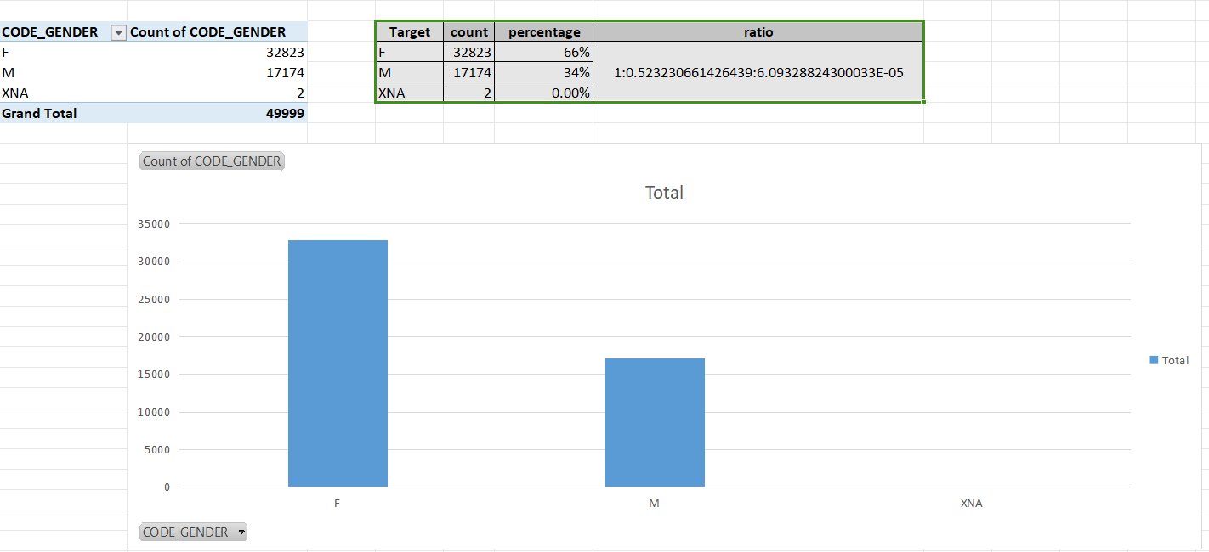
Data Imbalance in gender(for target 0 &1):
66% are female
34%are male

Slide 16
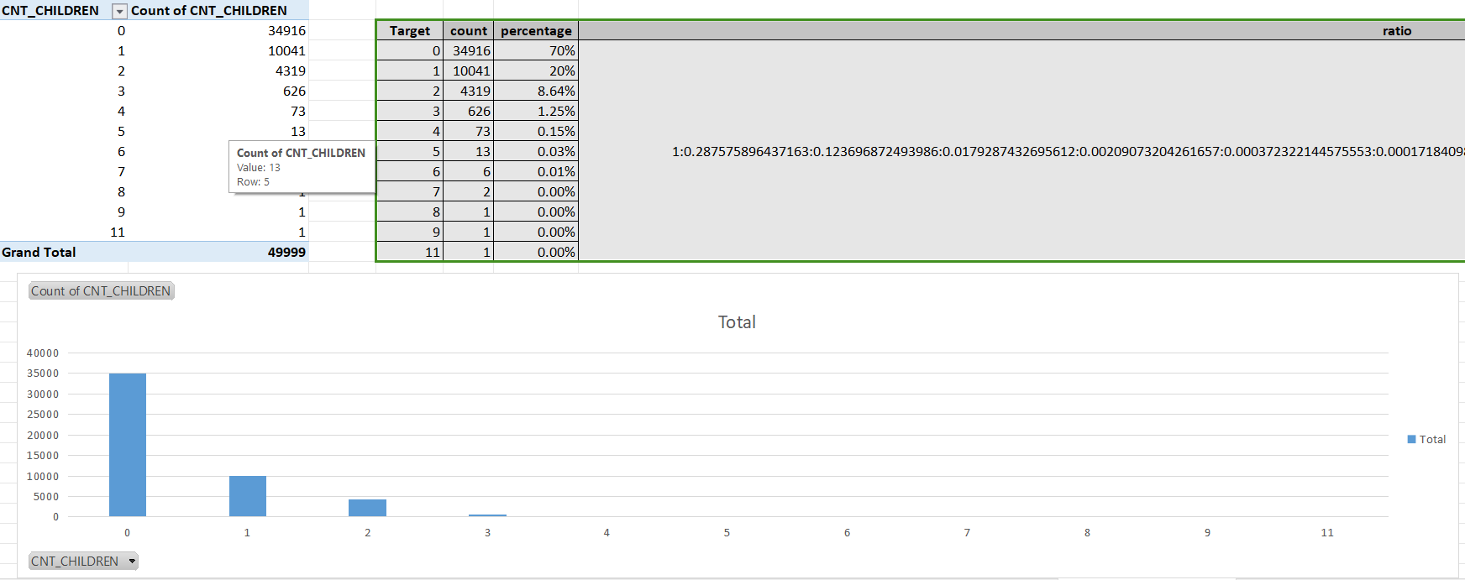
Data Imbalance in cnt_children(for target 0 &1):
70% are with no children
20% are with 1 children
8.6% are with 2children

Slide 17
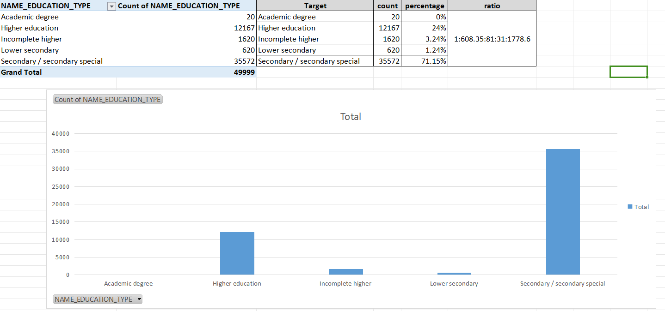
Data Imbalance in education(for target 0 &1):
71% are with secondary/secondary special education classification.

Slide 18
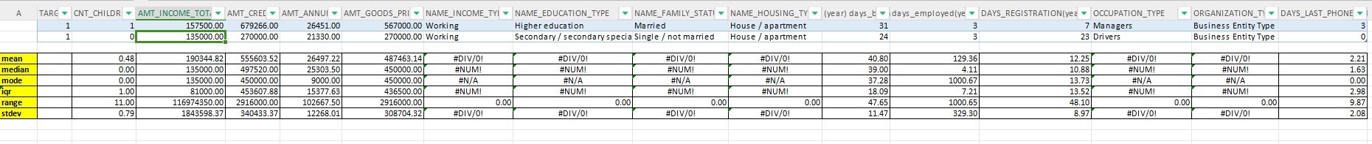
univeriate analysis of defatulters(1)
Univariate analysis is the simplest form of analyzing data. Uni means "one", so the data has only one variable (univariate).

Slide 19
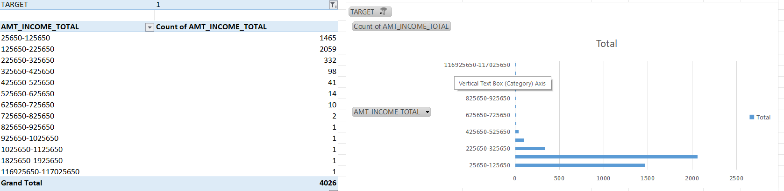
univeriate analysis of defatulters income(1)
Defaulters are more with income range of 25650-725650 .

Slide 20
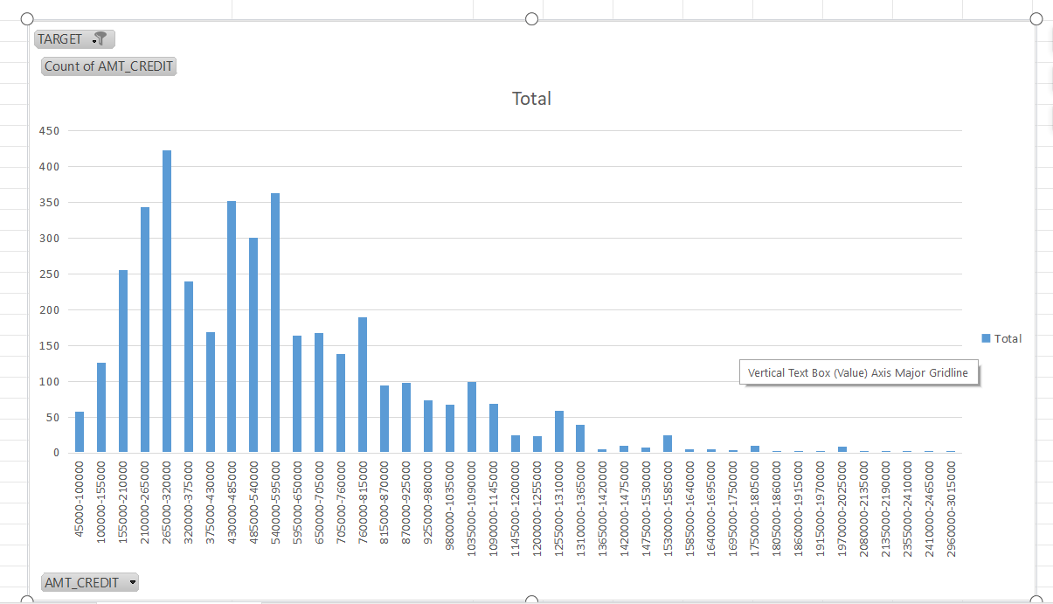
univeriate analysis of defatulters Amt_credit(1)
targets with higher credit amt will less likely to become a defaulter.

Slide 21
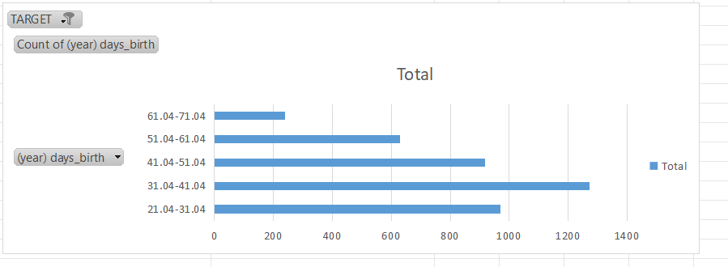
univeriate analysis of defatulters age(1)
middle age or lower age people are more likey to default.
the defaulters count decreases at higher age.

Slide 22
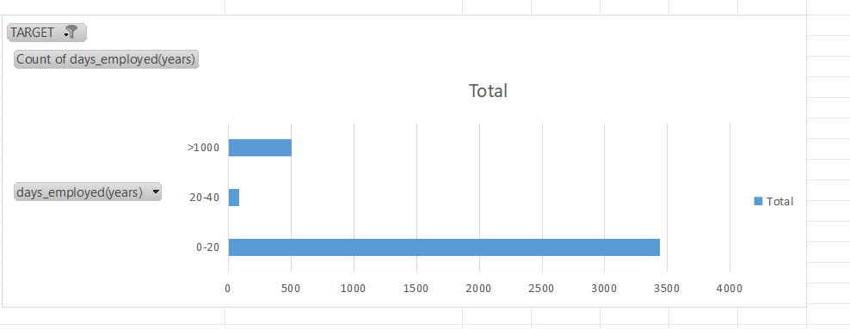
univeriate analysis of defatulters employment(1)
person with 0-20 yr of employment is more likely to default.

Slide 23
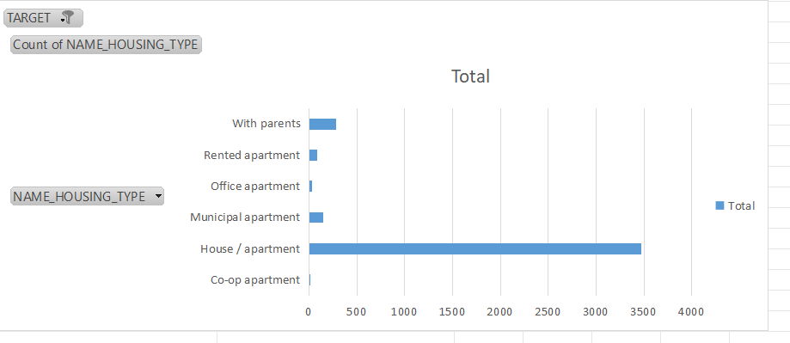
univeriate analysis of defatulters housing(1)
person with house/apartment are most likely to default.

Slide 24
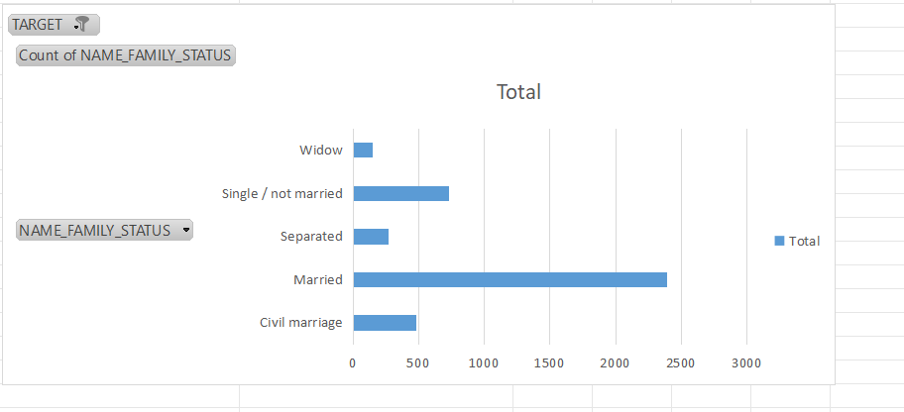
univeriate analysis of defatulters Family status(1)
married persons are more likely to default.

Slide 25
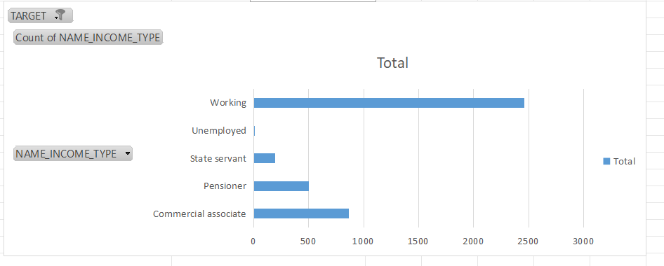
univeriate analysis of defatulters income type(1)
count of defaulter is more in working type
And count of defaulter is less in unemployed and state servent.

Slide 26
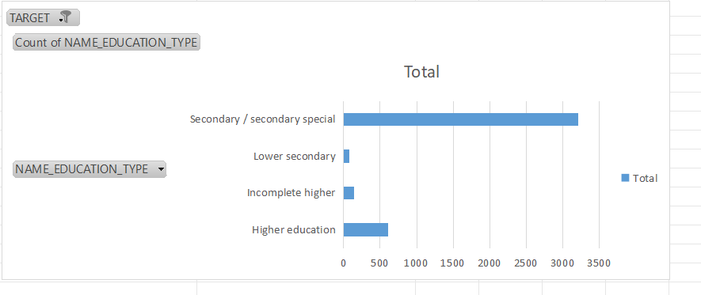
univeriate analysis of defatulters Education type(1)
Person with secondary/secondary special education have higher rate of defaulters
person with higher education are less likely to default.

Slide 27
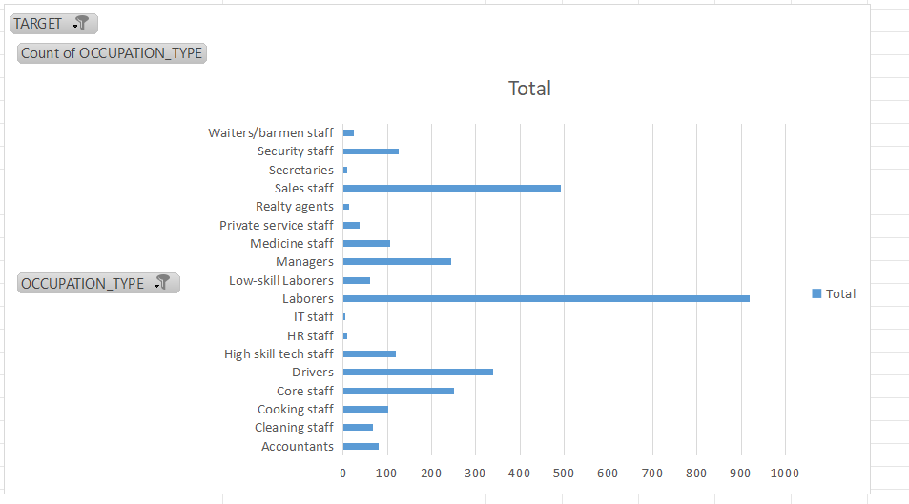
univeriate analysis of defatulters occupation type(1)
person with laborers and sales staff occupation has the higher rate of defaulters.
person with it or hr occupation has the lowest rate of defaulters.

Slide 28
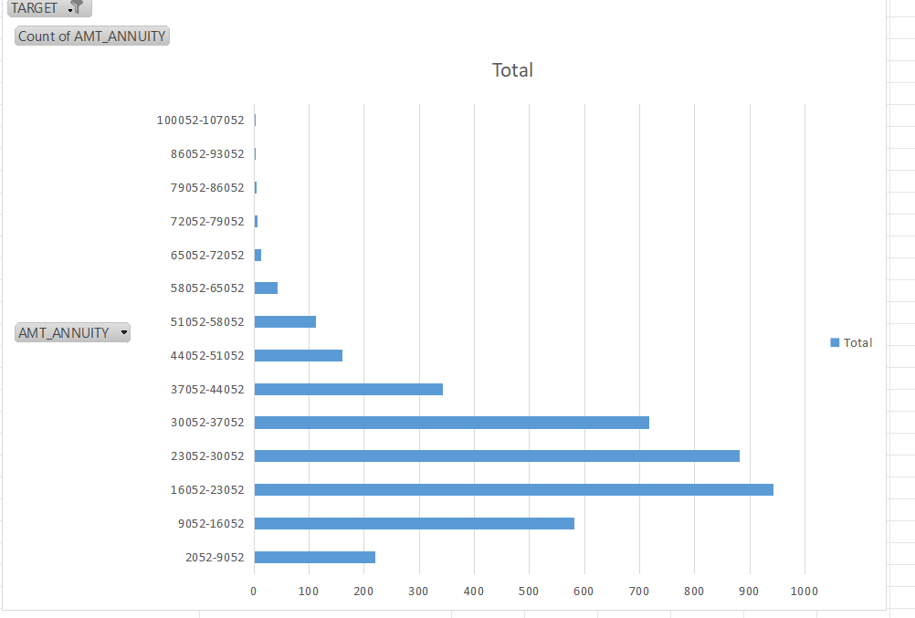
univeriate analysis of defatulters annuity amt(1)
rate of defaulter decreases as the annuity amt increases.
If the annuity amt is high then a person is less likely to default.

Slide 29
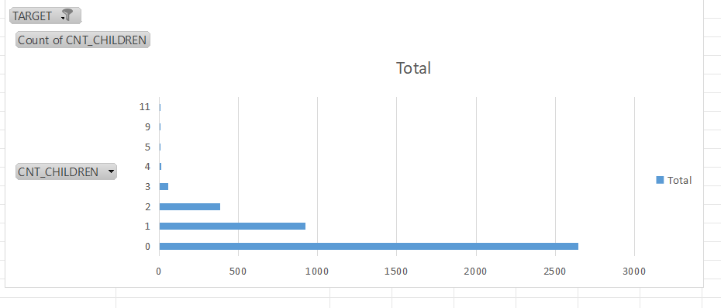
univeriate analysis of defatulters cnt_children(1)
person with no children will most likely to default.

Slide 30
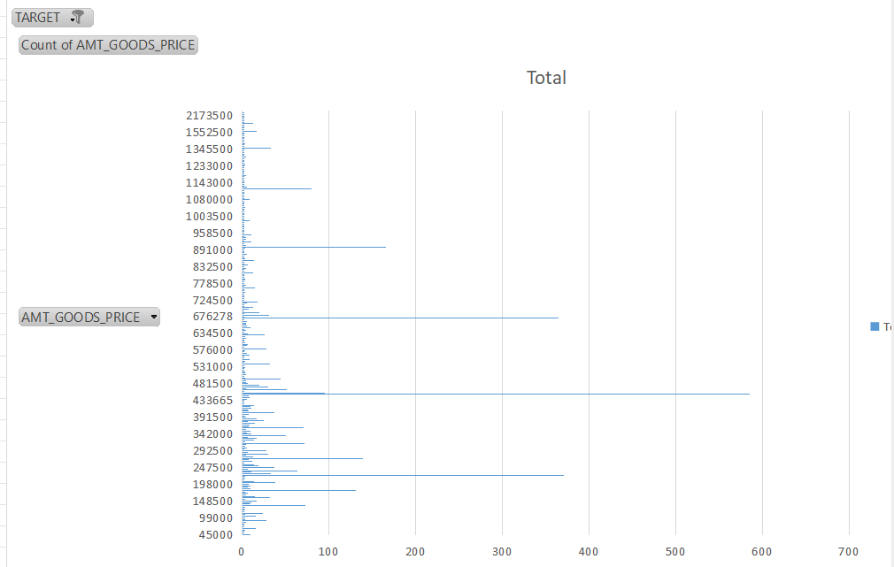
univeriate analysis of defatulters goods price(1)
loan given to a person with good price range between 433665-481500 is most likely to default.

Slide 31
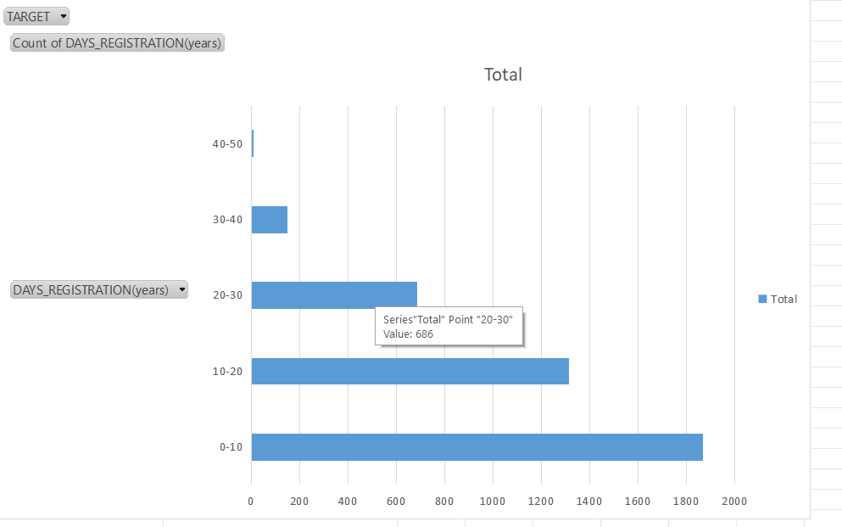
univeriate analysis of defatulters days registration(1)
if a person change its registration within 31 yr , the person might default its payment.
As the day of registration increases the count of defaulters decraeses.

Slide 32
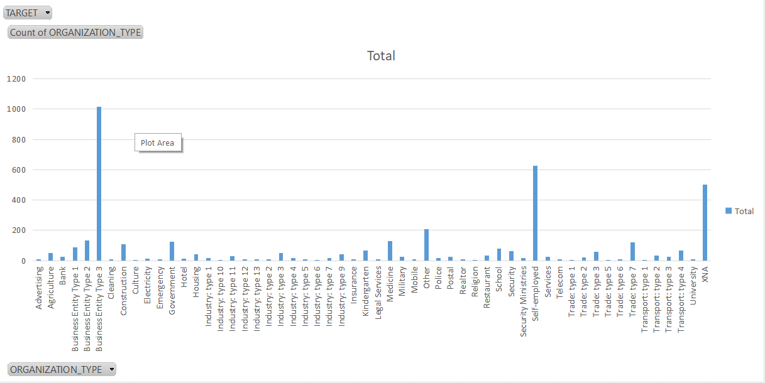
univeriate analysis of defatulters organization type(1)
person from organization like bussiness entity type 3 , self employed & xna are more likely to default.

Slide 33
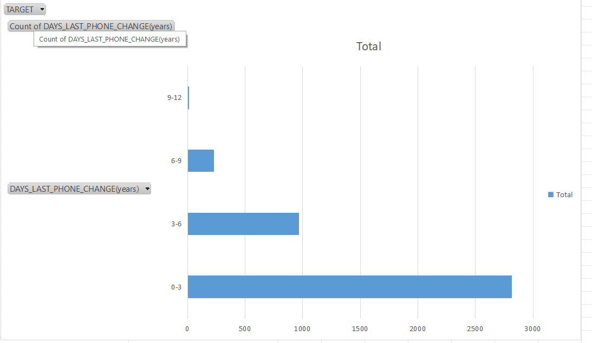
univeriate analysis of defatulters phone_change(1)
if a person changed its phone within 0-6 yr before applying for loan,then he/she is more likely to default.
if a person did not change the number before applying for loan the he/she will less likely to default its payment.

Slide 34
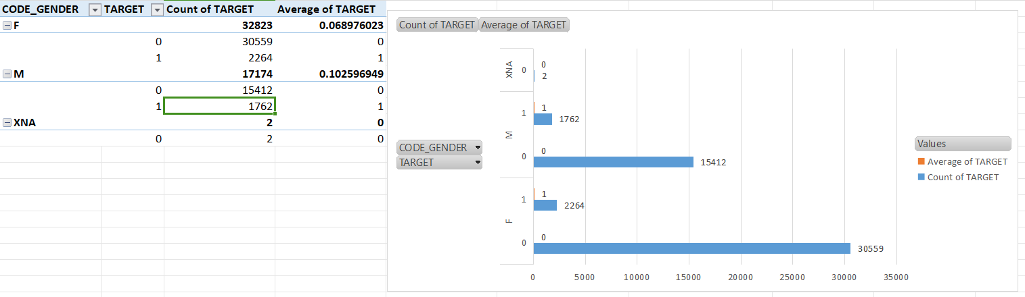
Segmented univeriate analysis by gender
Female target took more loan as compair to males.
males tend to default more as compair to female.

Slide 35
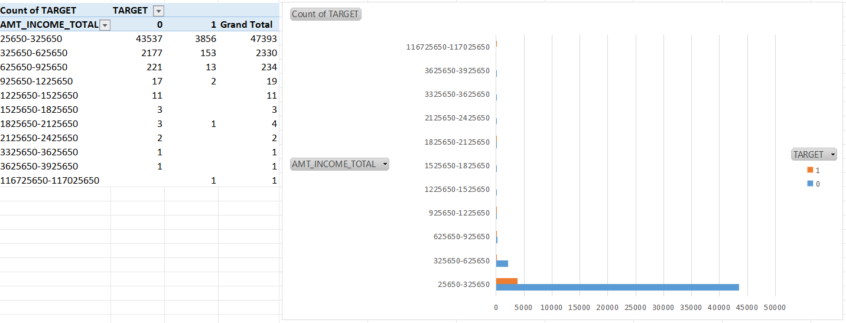
Segmented univeriate analysis by amt_income
a preson with income 25650-325650 is likely to take loan.
a person with higher income does not need a loan.

Slide 36
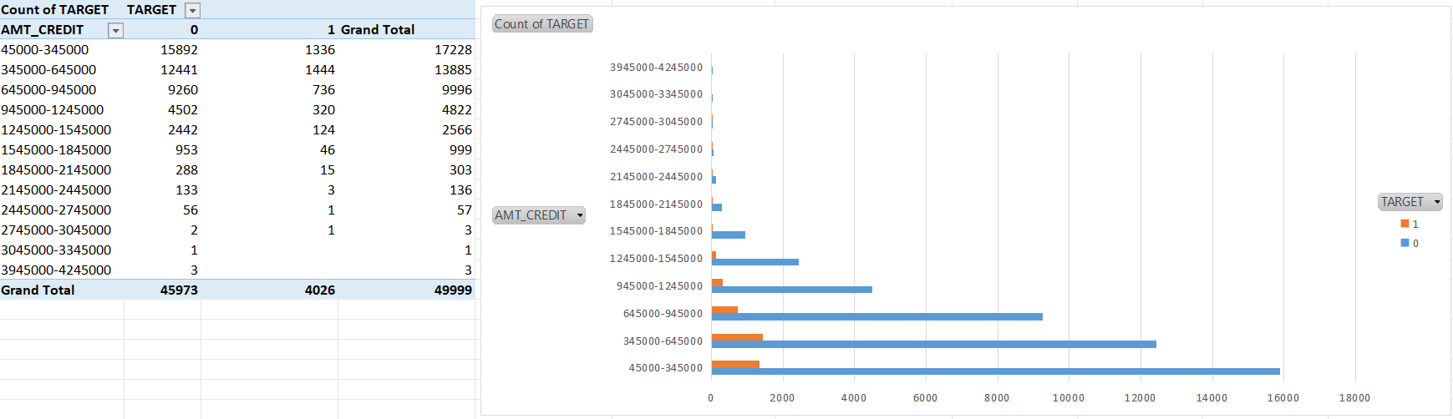
Segmented univeriate analysis by amt_income
the higher the credit amount the lesser chance of getting a defaulters.
the defaulter count is high at lower credit amt.

Slide 37
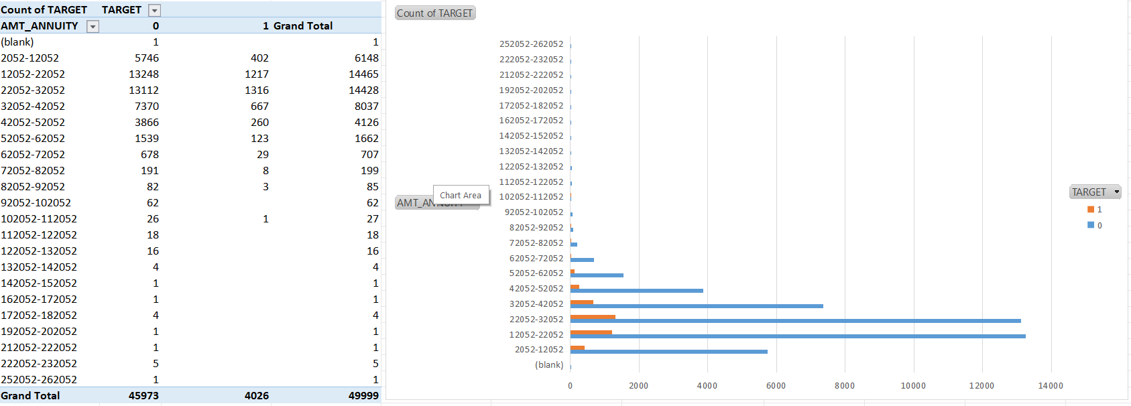
Segmented univeriate analysis by amt_annuity
the higher the annuity amt the less chance of getting defaulters.
but count of payers are more as compair to defaulters at low annuity amt.

Slide 38
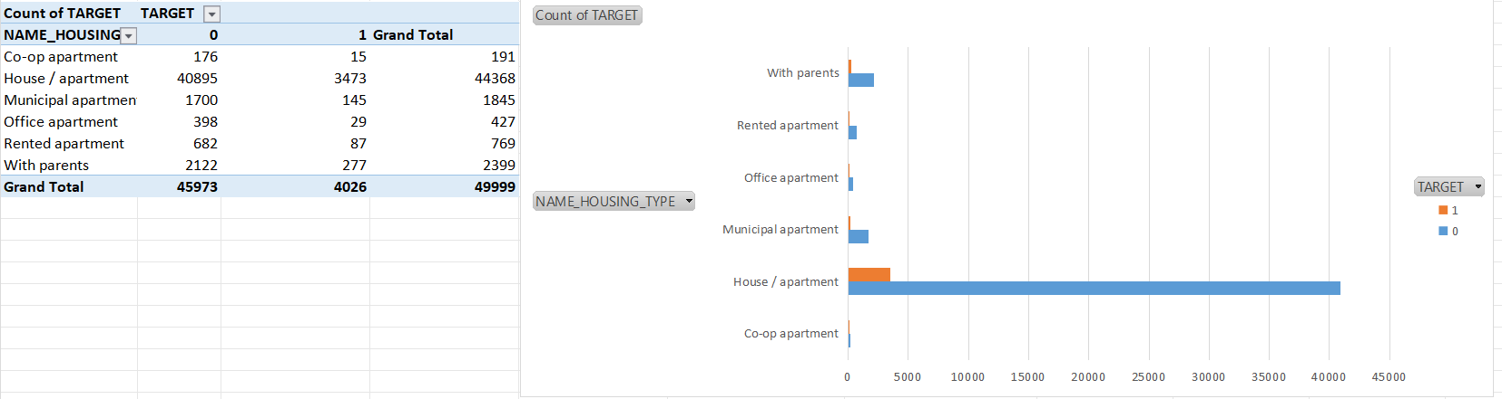
Segmented univeriate analysis by housing
a person with house/apartment has a high chance to take a loan
But defaulter rate is also high with the person having house/appartment as they may have other emi’s to pay.

Slide 39
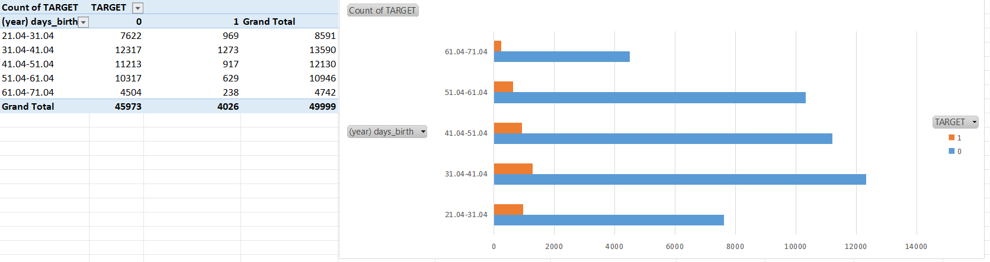
Segmented univeriate analysis by birth

Slide 40
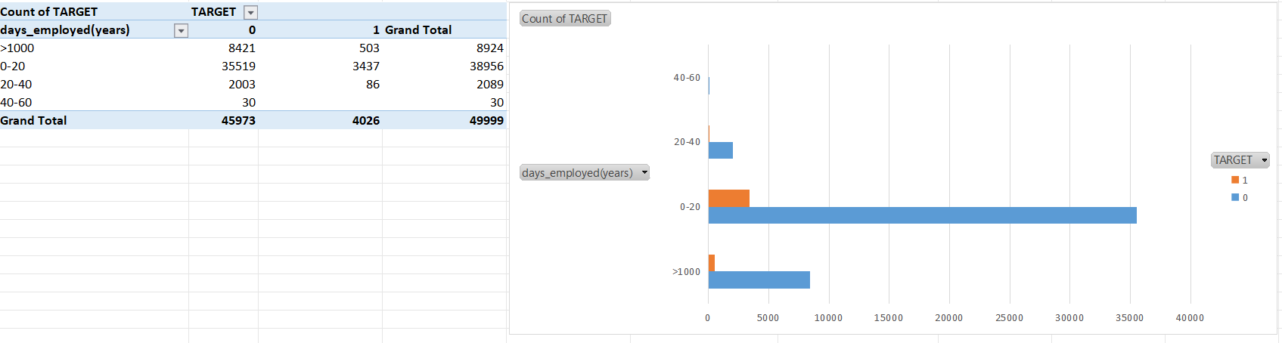
Segmented univeriate analysis by days employed

Slide 41
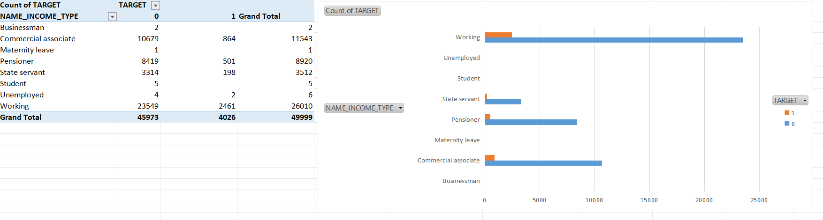
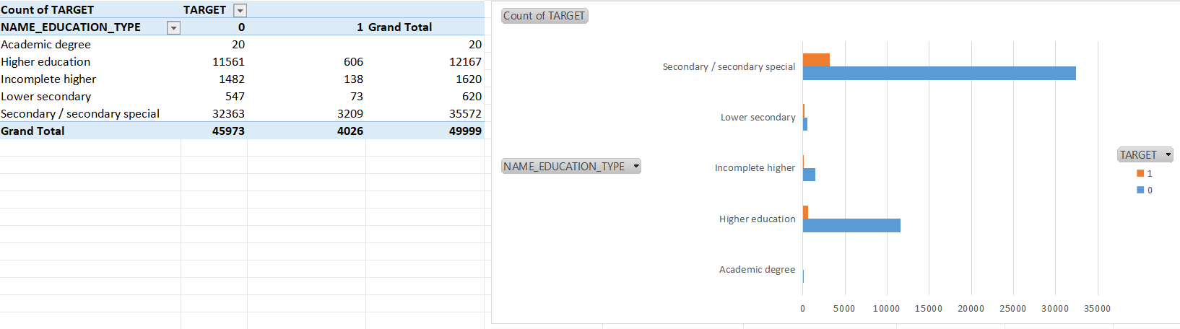

Slide 42
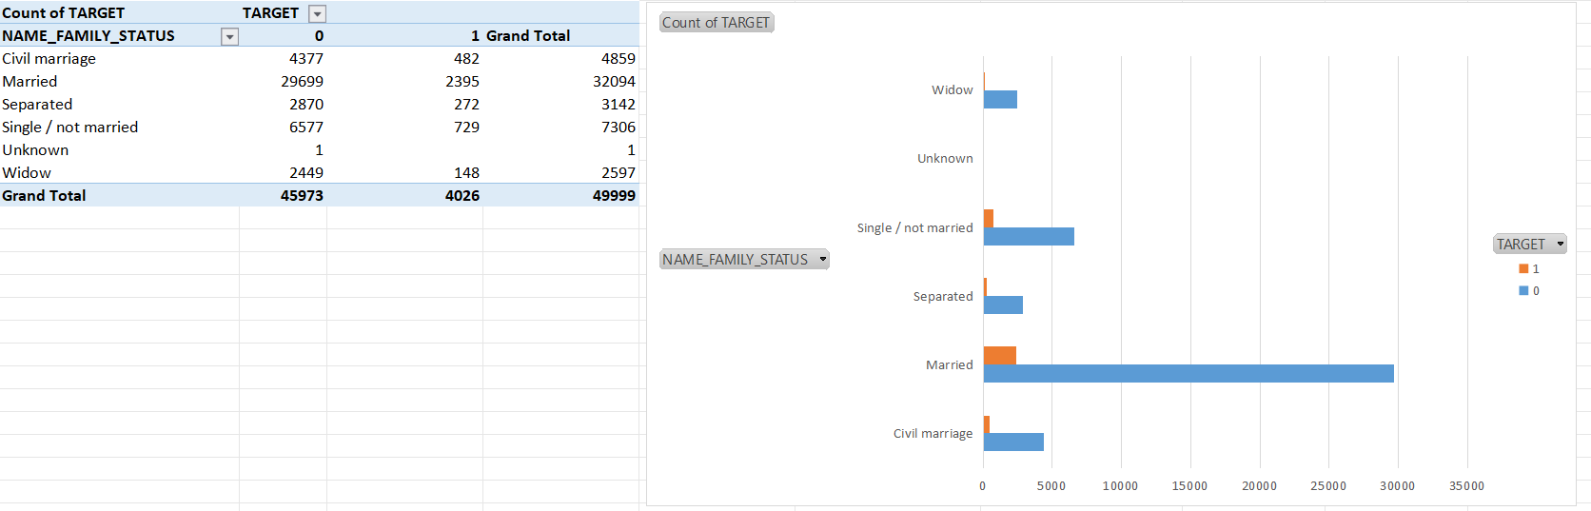
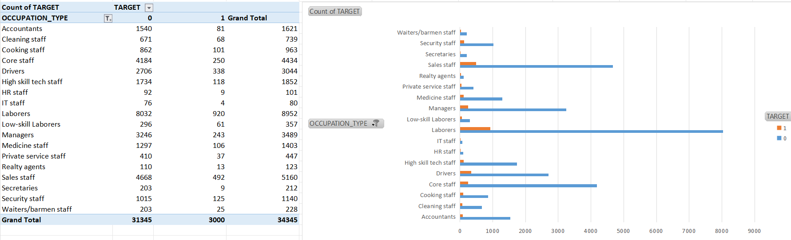

Slide 43
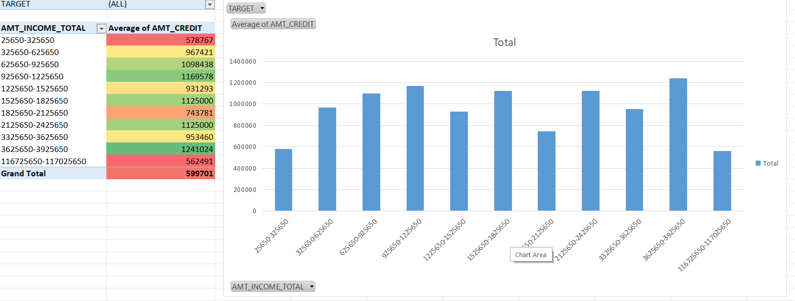
Biveriate analysis
their is an uneven relationship between income and credit.

Slide 44
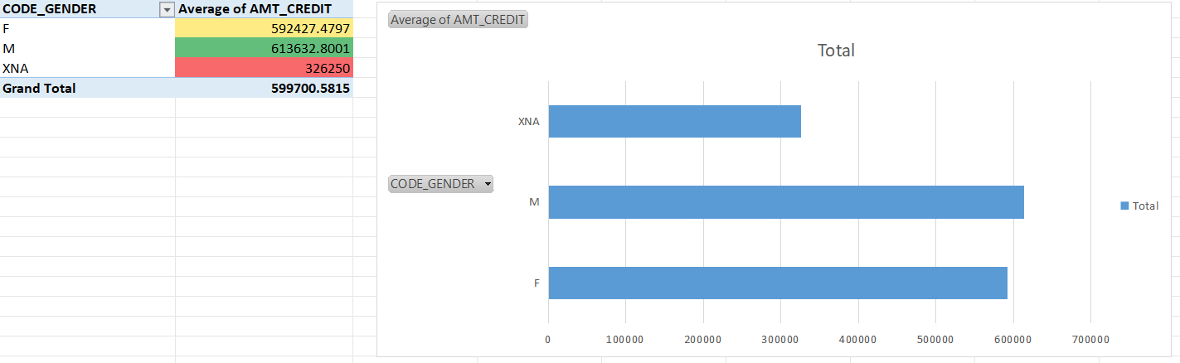
male tends to take higher credit amt as compair to female.

Slide 45
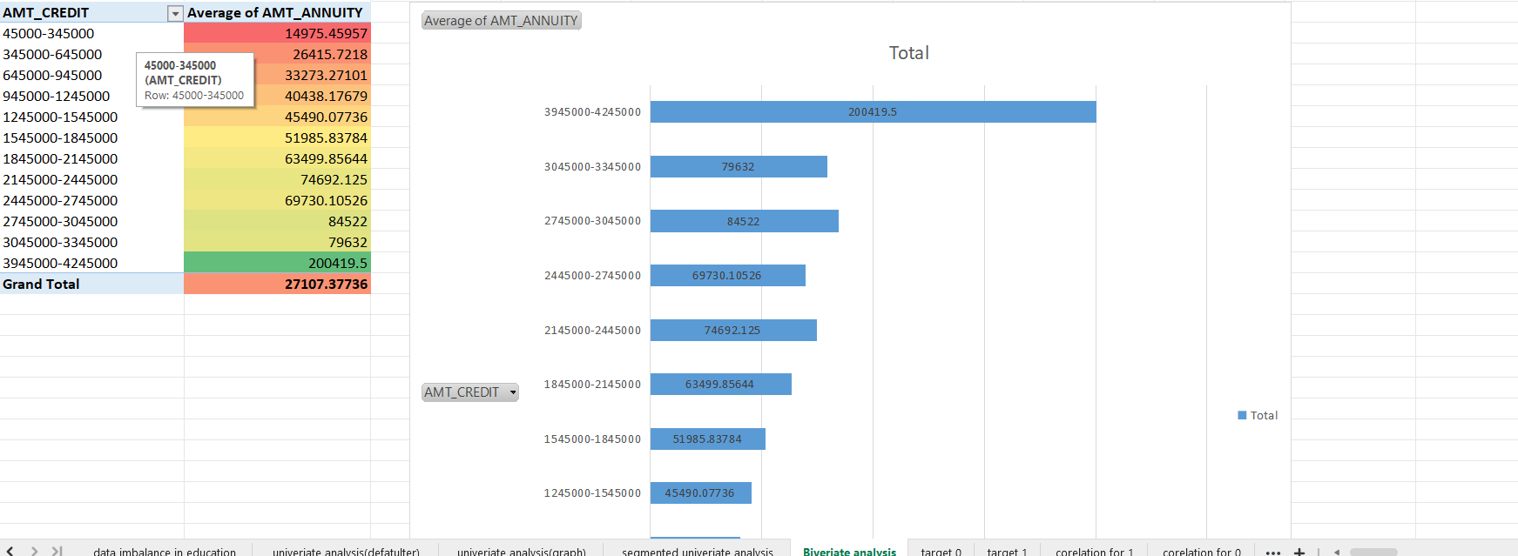
amt_credit and amt_annuity has a posivite relation between them,the higher the credit the higher the annuity amt.

Slide 46
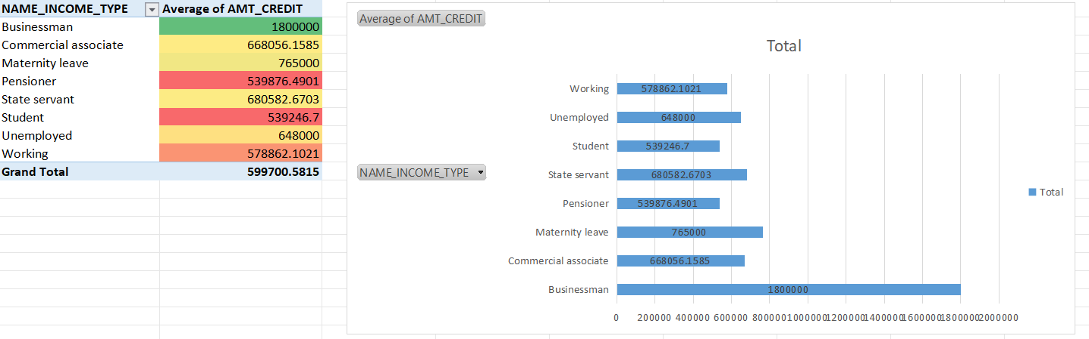
businessman tends to get higher credit_amt.

Slide 47
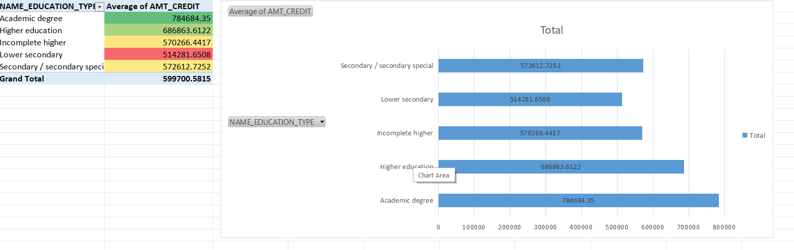
academic degree & higher education person takes high credit amt.

Slide 48
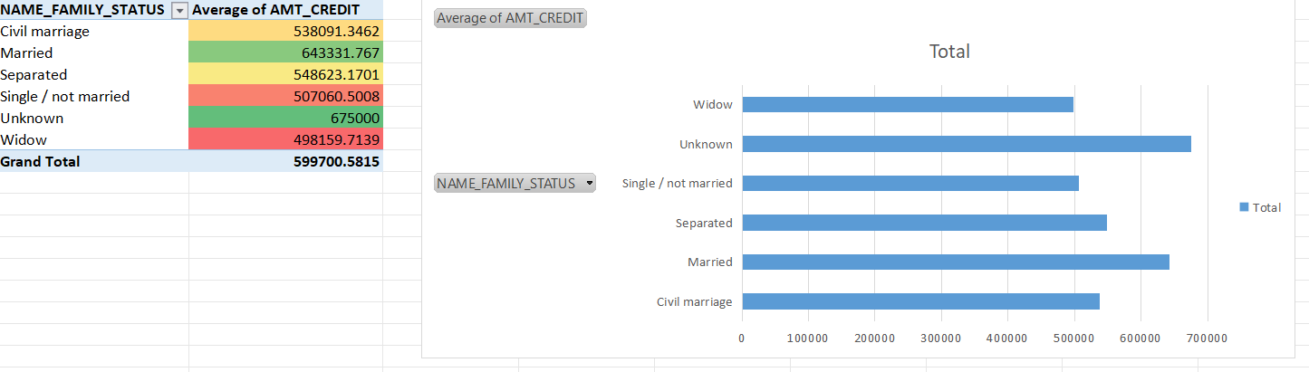
married person takes high loan.

Slide 49
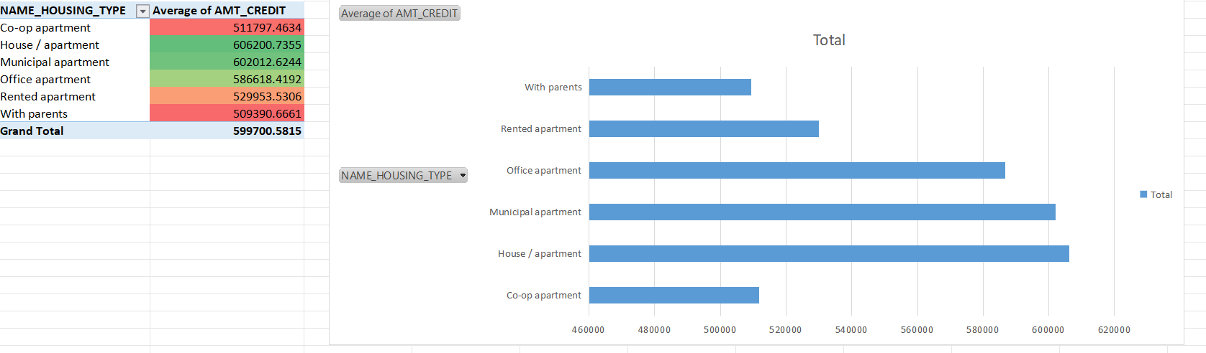
person with house/appartment,municipal apartment and officce appartment takes high loan.

Slide 50
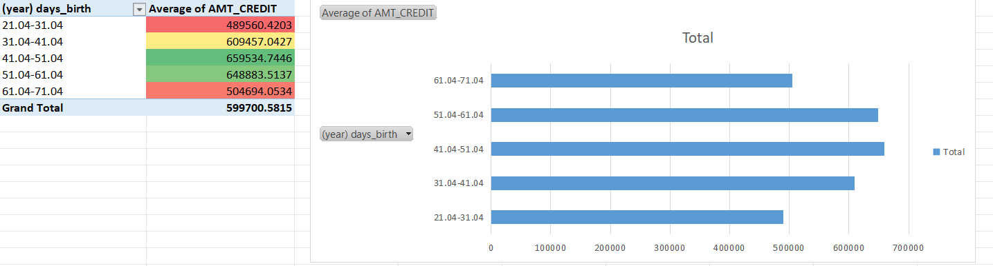
person with age between 41-61 takes higher loan.

Slide 51
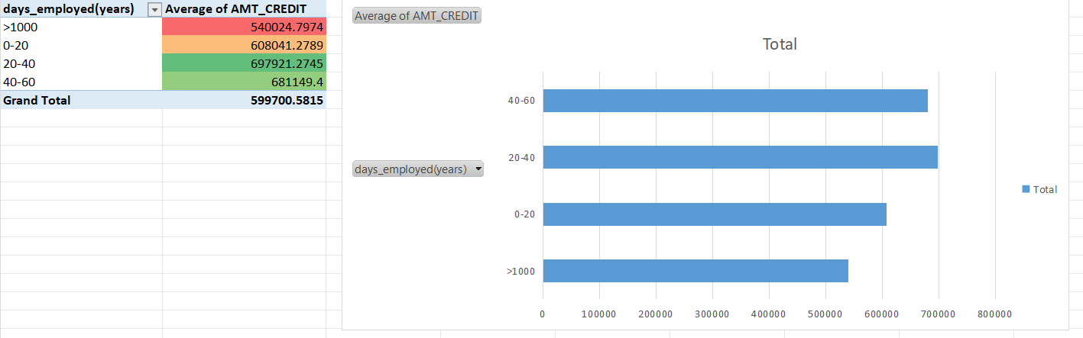
person with days employed between 20-60 take high loan.

Slide 52

person with occupation type accountants,managers,etc take high loans

Slide 53


Correlation of defaulters
correlation of payers
cells mark with green has strong correlation,cells mark with yellow &orange has modarate correlation & cells with red mark has weak correlation.

Slide 54
Insights:
Their are less count of defaulters in total loan in comparison to count of non-defaulters.
Amt_income_total :Applicants with income more than 3,25,650 are less likely to default.
amt_credit:risk of having a defaulter is high at low credit amount.
The bank can earn profit by keeping higher annuity amount as their are less defaulters at higer annuity.
Education type:academic degree has no defaulter.
Income_type:Student,bussinessman & maternity leave have no defaulters.
Organization_type:Applicants from organization like bussiness entity type 3 , self employed & xna are more likely to default.
Days_birth:People above age 50 have low probability of defaulting.
Days_employeed:applicants with 40+ year of experience has less default rate.
Cnt_children:Applicants with children are less likely to default.
Code_gender:Mens are at relatively have higher default rate.
Name_family_status:Applicants who are single/civilmarriage default a lot.
Occupation_type:avoid lowskill laborers,Sales_staff,drivers,waiter staff,securirt staff ,laborers&cooking staff as their default rate is high.
Phone_change:if an applicant changed its phone within 0-6 yr before applying for loan,then he/she is more likely to default.

Slide 55
Result:
Ater performing the analysis we can rectify whether a applicant will repay the loan or not.
The people who are likely to face problem in loan repayment are labourers.
people with secondary/secondary special education might face problem in loan repayment.
Moreover those who are living in house/apartment are facing difficulty in loan repayment.
loan highly recommended group:married client,senior clients, more educated clints,applicants with high income,females,applicants with strong work exprience.
loan highly risk group:Applicants that are unemployed,youth applicants,applicants with low income,applicants with little work experience,applicants with no children,applicants who have recently changed their phone.

Slide 56
The End
email:Jeetchoudhury76@gmail.com
https://docs.google.com/spreadsheets/d/1NEveJooSLHrb9U2_QZp_AG-g2WDMrTF5/edit?usp=drivesdk&ouid=111398243446314990339&rtpof=true&sd=true

